Slide 1
CLATSOP County Emergency operations center (EOC) User Guide: Basecamp FOR cooperators
Revised: 04/08/21

Slide 2
Overview
Section A – Overview of Basecamp program
Section B - Setting up an account and changing notifications
Section C - How to use Basecamp during EOC activation
Section D – Adding additional agency staff to Basecamp
Section E – Who to contact for assistance

Slide 3
Section a basecamp overview

Slide 4
Basecamp overview
What is Basecamp?
A project management web based software program that Clatsop County EOC is using to coordinate internal EOC operations and interactions with Cooperators
Internet based with mobile phone application for both Android and IOS
Provides platform to schedule/assign to do items, document storage, message chat to specific groups, calendar for specific projects
Allows authorized members to add additional staff quickly and easily
How will Clatsop County use Basecamp to manage EOC activations?
Clatsop County has divided Basecamp into three sections:
IMT Hub\County EOC (library of forms, tools)
City EOC resources
Projects – Cooperators folder and EOC activation folder (live EOC response documents)

Slide 5
Cooperators access and use
Cooperators will be given access to 1 folder – “COOPERATORS – Clatsop County”
Cooperators will be able to DROP OFF documents related to the current activation such as:
Resource requests
City/Tribal EOC Action Plans
Situational Status Reports
Incident Command Incident Action Plans (IAP’s)
Damage Assessment Reports
Cooperators will be able to PICK UP documents from the County EOC related to the current activation such as:
Media Releases and Public Summary Reports
County Situational Status Reports
Cooperators will be able to download EOC templates to assist them with their activations

Slide 6
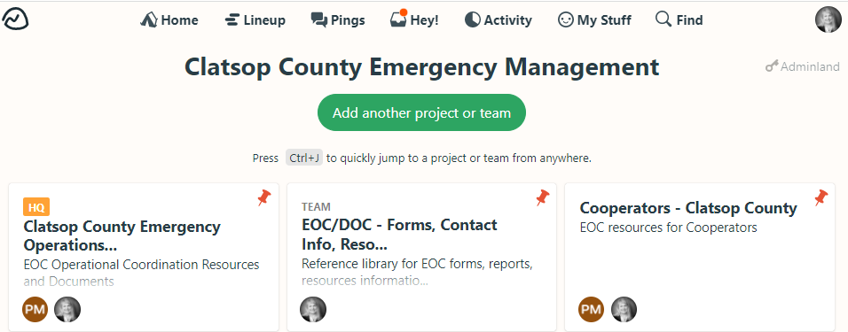
Admin hub (top of basecamp screen)
Your agency logo and account name
Your Avatar (name/photo) is at the top right – you also click here to change your settings
Each circle represents a person who has access to this area

Slide 7
Teams: Internal eoc section folders
This section is for internal County EOC staff but can also be created for city/district cooperators as well.
EOC/DOC library contains forms, tools, contact information, spreadsheets needed to complete assigned EOC functions.

Slide 8
Project access: cooperators folders and JIC activation folder
Cooperators Folder
Drop off documents
Pick up information from County EOC
EOC Activation Template Folder – Document & Resource Library
JIC Activation Team – For coordinated messaging across jurisdictions

Slide 9
Section B SETTING UP an ACCOUNT AND NOTIFICATIONS

Slide 10
Setting up your basecamp profile
You’ll receive an invite from Clatsop County EOC
Create your user name and password
If you have a google account you can use this to access
Set-up your profile information and notifications
Add your picture – this is super helpful so others who are activated can see who you are if you are in another location/room and they may not know you
Notifications – you will most likely want to “turn off” your notifications until we have a real activation…Basecamp is a little “chatty”, turning them off until an activation occurs will be helpful to you

Slide 11
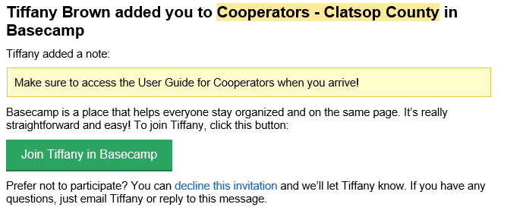
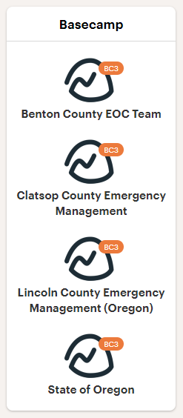
Email from basecamp/set-up
Initial Basecamp Invite to Cooperators will come from Tiffany Brown or EM Assistant Pooka Morales
If you invite more of your staff to have access then the invite will come from your email
You may have access to more than 1 Basecamp
Clatsop County Emergency Management (Oregon)

Slide 12
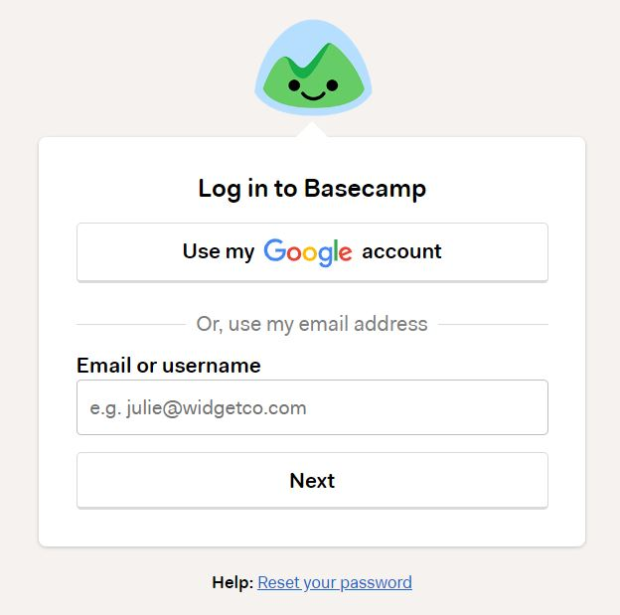
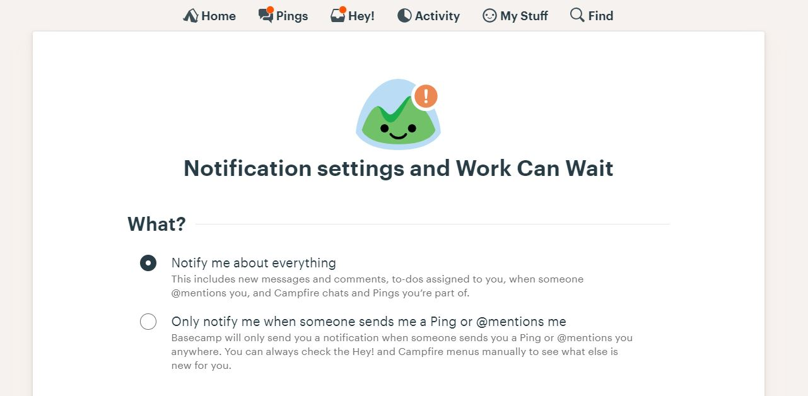
Log in/settings
If you have a Google account you can connect for the same log in
Consider turning off your notifications until the EOC is activated…Basecamp can be a little chatty

Slide 13
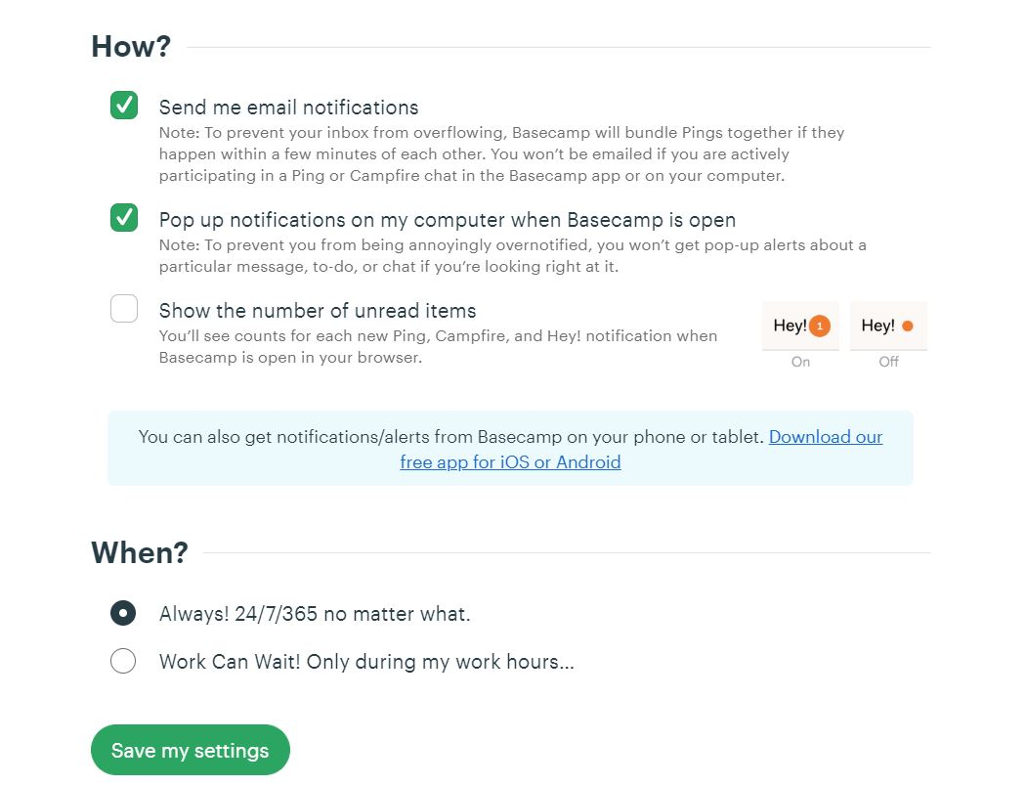
Notifications page 2
Additional settings to change for notifications
You can download the mobile app which is quite easy to use and great to connect to EOC when you are away from your desk top for activations

Slide 14
Section C USING BASECAMP during an EOC activation

Slide 15
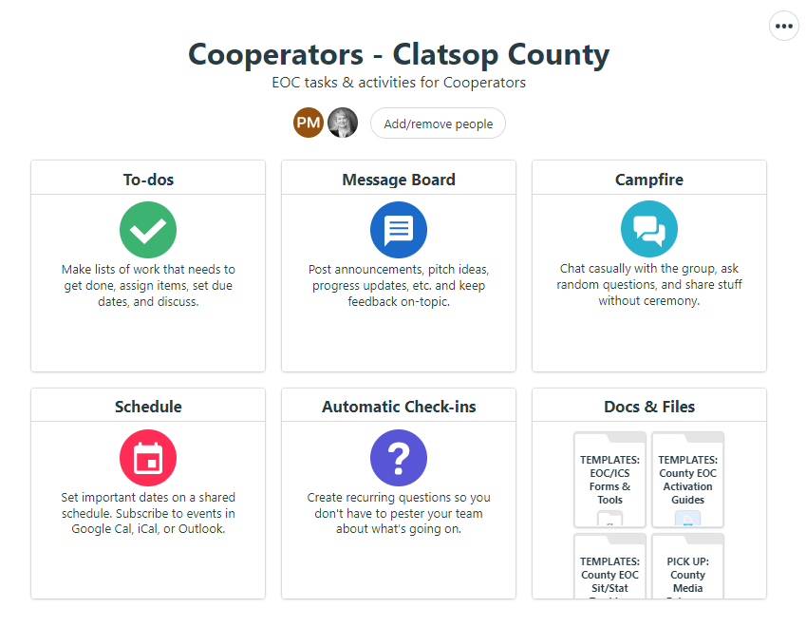
COOPERATORS FOLDER
The two areas the Cooperators will use the most are
MESSAGE BOARD and
DOCS & FILES
Some of the features in Basecamp are still new to us and we are learning how best to work them towards our advantage. (Brown)

Slide 16
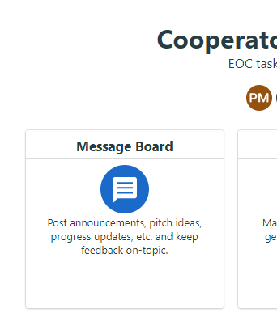
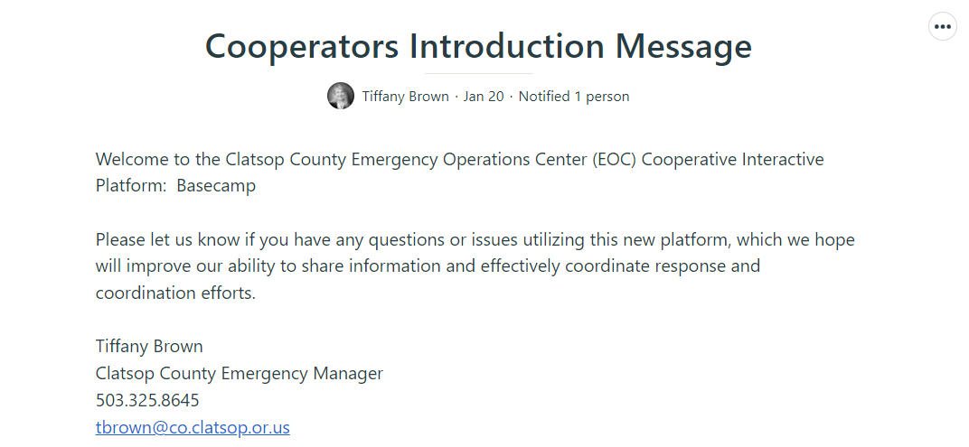
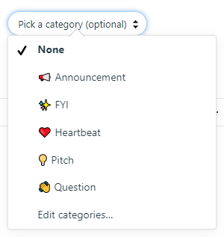
Cooperators: message board
Cooperators will be able to have conversations with other Cooperators and with the County EOC through the MESSAGE BOARD
Types of Messages:
Ask a Question!

Slide 17
Cooperators: doc’s and files
DROP OFF Documents to County EOC
Basecamp is the primary way to exchange information with the County EOC
The most common files a City, Public Safety, Special District will share or DROP OFF are for the County EOC are:
Damage Assessment Reports
EOC Action Plans for Sit Stat Reporting
ICP Incident Action Plans
Resource Requests for Processing

Slide 18
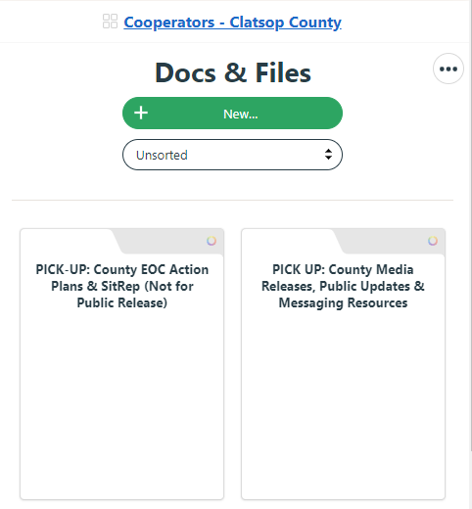
Cooperators: doc’s and files
Basecamp will be the primary way to exchange information with the County EOC
The most common files a City, Public Safety, Special District will PICK UP or retrieve with the County EOC are:
Completed County EOC Action Plans (not for public release)
County EOC Situation Reports (not for public release)
Media Releases and Public Updates
PICK UP Documents from the County EOC

Slide 19
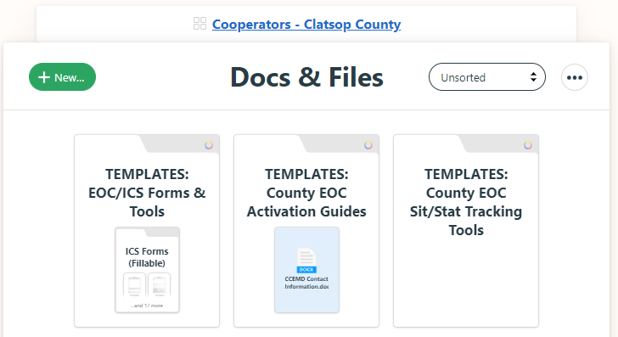
Cooperator documents folders
Standard
Fillable ICS Forms
EOC Activation Resources
Situation Reporting Tools

Slide 20
Section D ADDING agency PERSONNEL

Slide 21
Adding additional agency reps
Cooperators who were originally invited to Clatsop EOC Basecamp can add additional agency representatives pre-event or during activations following these easy steps
Do not add individuals unless they are a designated employee or volunteer without County EOC Director permission
Inform these individuals the information in Basecamp is for official use only with the exception of Media Releases and Public Summary Updates
Cooperator Agency Leads can remove agency reps at any time and/or by sending an email to County EM to ask for them to be permanently removed
County EM will periodically review active members and delete, archive as appropriate with communication to the Agency Lead

Slide 22
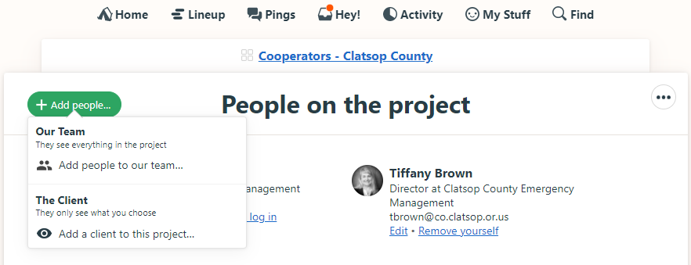
Adding additional agency reps
Select Add/Remove people at the top of your Cooperator Screen
Select “Our Team”
Do Not select “THE CLIENT”

Slide 23
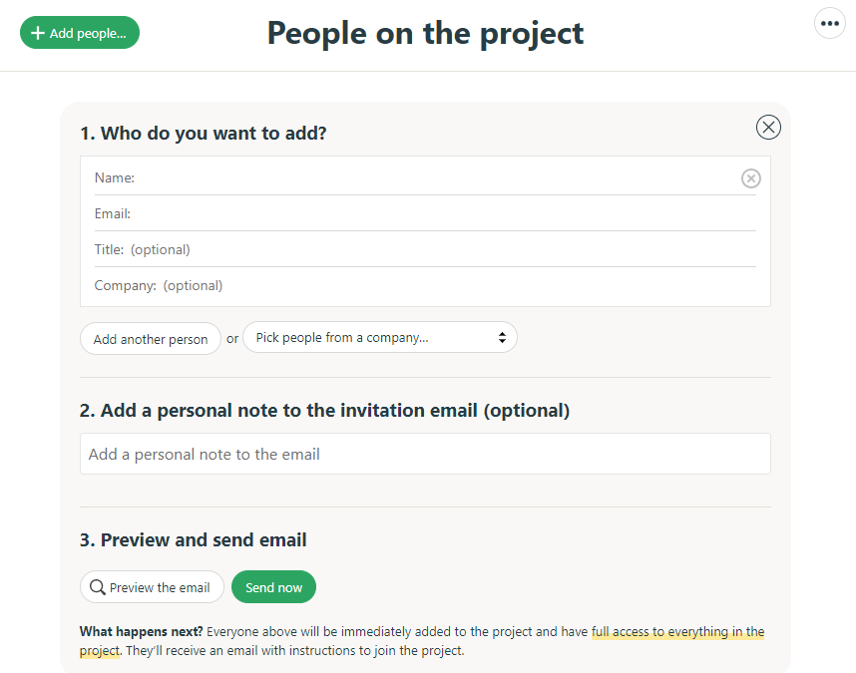
Adding additional agency reps
Enter their name, email information
You can add more than one person at a time
You can pick from people who are already in Basecamp..it should tell you if they are already there and let you add them
Include an intro message explaining why they are being added

Slide 24
Section e Who do I contact for assistance?

Slide 25
Need help?
Contact County EM staff to walk through any issues you may be having.
One tricky issue that some have run into was when connecting the initial user name/password to Google accounts…have patience and you may have to sign on and off a few times for it to connect
If you have any feedback for us please let us know as we want to ensure this is an easy transition and an effective tool.
BASECAMP: https://basecamp.com/
Tiffany Brown Emergency Manager Clatsop County Emergency Mgmt 91372 Pacific-Rilea Road, Bldg 7404
Warrenton, Oregon 97146 tbrown@co.clatsop.or.us
(503) 325-8645 Office (503) 791-7060 Cell
Laura “Pooka” Morales Program Assistant Clatsop County Emergency Mgmt 91372 Pacific-Rilea Road, Bldg 7404
Warrenton, Oregon 97146 lmorales@co.clatsop.or.us
(503) 325-8645 Office (503) 791-7060 Cell

