Slide 1
CLATSOP County User guide Clatsop Alerts: Group Managers (Organization: Agency Alerts)
Revised: 03/15/20

Slide 2
Overview
SECTION A: Adding New Contacts
SECTION B: Managing your Group(s)
SECTION C: Sending Messages and Message Delivery Settings
SECTION D: Assistance – Who to Contact

Slide 3
Section A: Adding new contacts

Slide 4
New Contacts – Important to note
When you add new contacts to your group, you must:
Use their personal cell phone with no spaces or dashes as their external ID (ex. 5418675309)
Include an email address in their device listing at which they can receive the invitation to update their account and future communications.
Put their cell phone as the priority method of communication
New contacts must have the following in order to receive messages:
(1) add home agency (your agency) to the contact
(2) after you create the contact add the new contact to the group from the “groups” tab

Slide 5
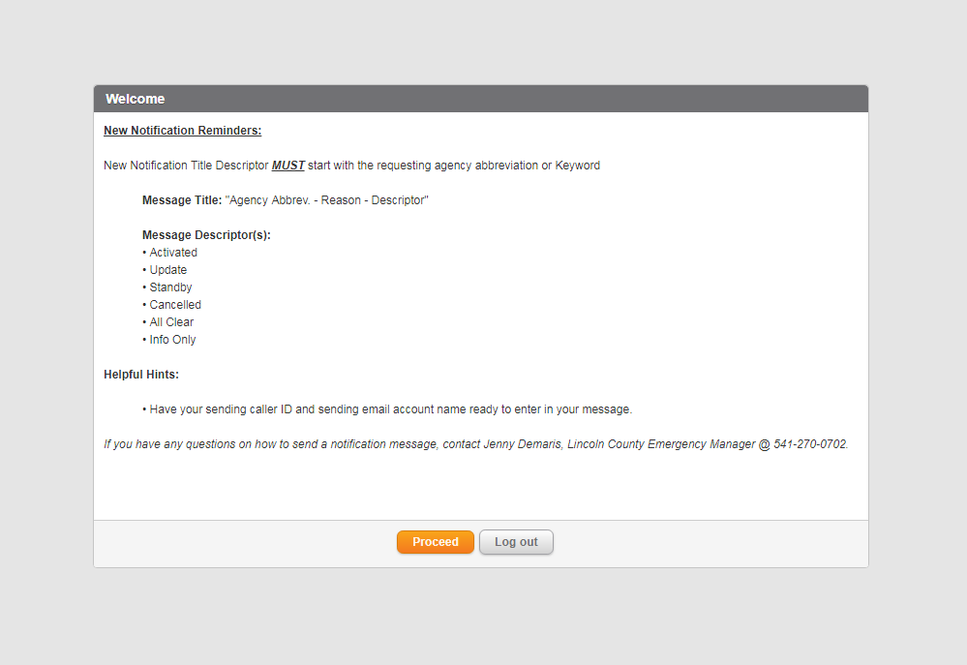
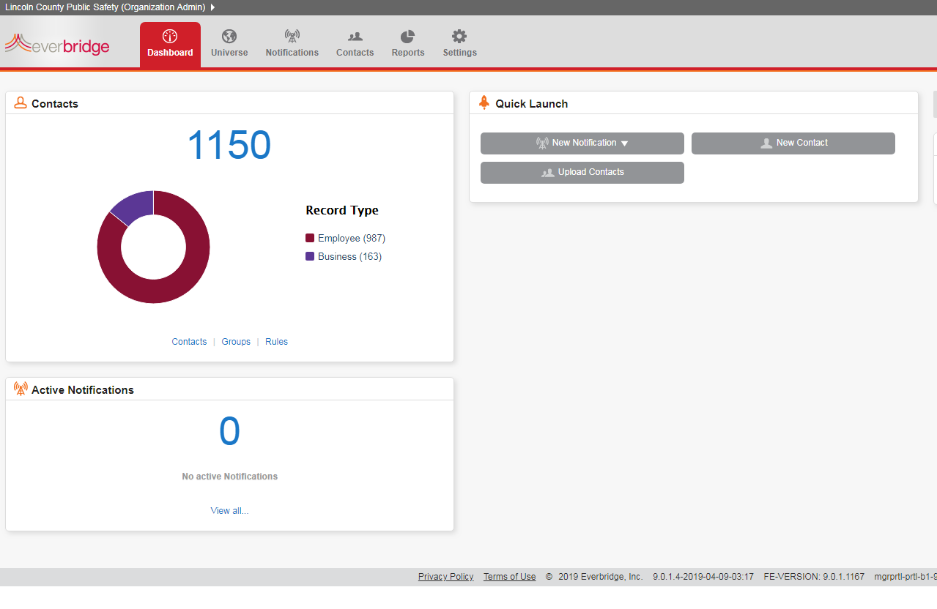
New Contacts – How to Get there
Log in to Everbridge and click “proceed” on the welcome message
Click the “Contacts” tab from the dashboard to access the contacts that are available to you.

Slide 6
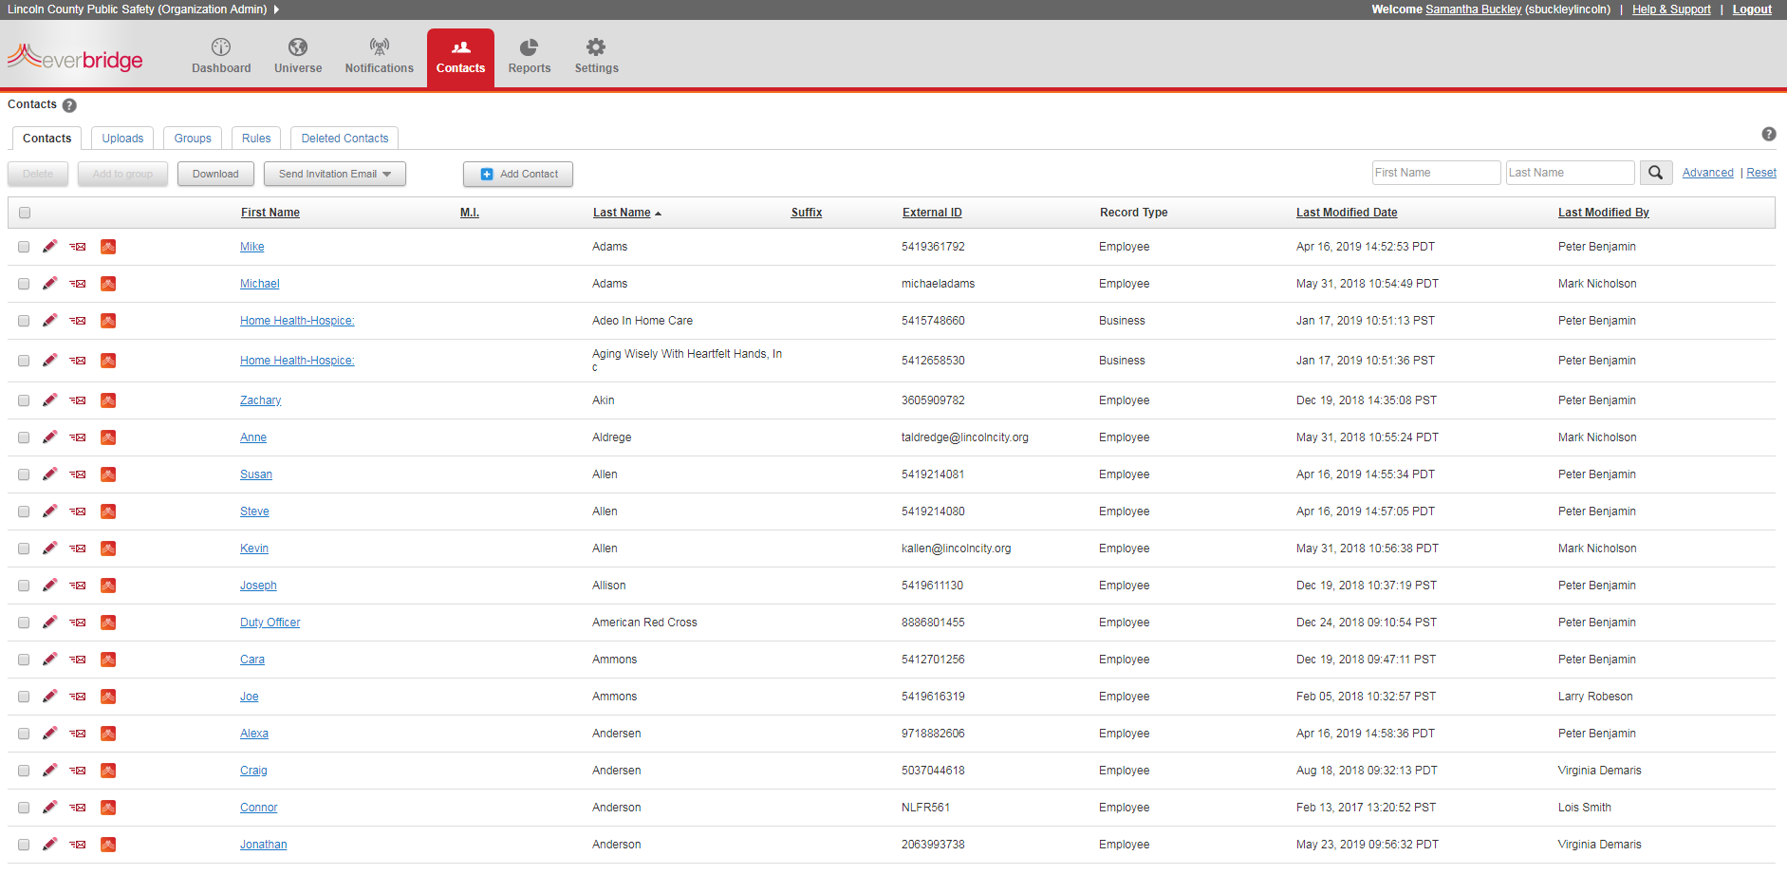
The Contacts Tab
Utilize “add contact” to add new personnel to Everbridge
Access your groups by selecting the “groups” tab
Search for personnel to update information using the search bars

Slide 7
Adding a New Contact
Enter general information. Use personal cell phone with no spaces or dashes as External ID
Select delivery (contact) methods from the available drop down list.
Use the arrows on the left to organize the delivery methods in the preferred order. Emergency Management recommends putting personal SMS TXT as first preferred delivery method.
Be sure to include an email address so the new contact can receive a registration email.

Slide 8
Adding a New Contact
Add your home agency to the new personnel profile by selecting it from the list on the left.
Using the arrows in the middle, move the appropriate home agencies from the left to the right.
Save the contact using the “Save” key at the bottom on the screen.

Slide 9
Section b: managing your groups

Slide 10
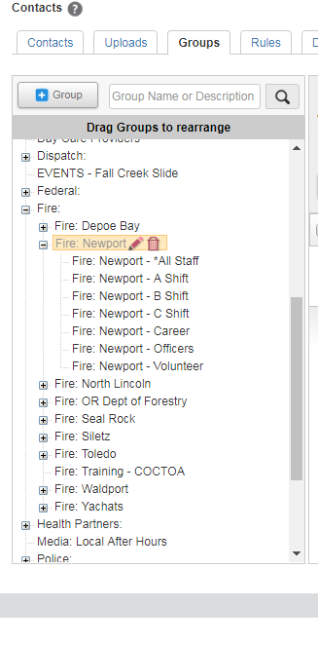
Managing a Group
To access Groups, click on the “Groups” tab.
You will only be able to see the groups that you have access to. To add someone to a group, select the group from the menu bar on the left.

Slide 11
Organizing groups
You can organize your group as is most helpful for your agency.
Emergency Management recommends including subgroups for any combination of people that you may need to contact quickly.
You are responsible for ensuring that your subgroups are up-to-date with new hires, volunteers, or departures from your organization.
Maintain continuity between your group names.

Slide 12
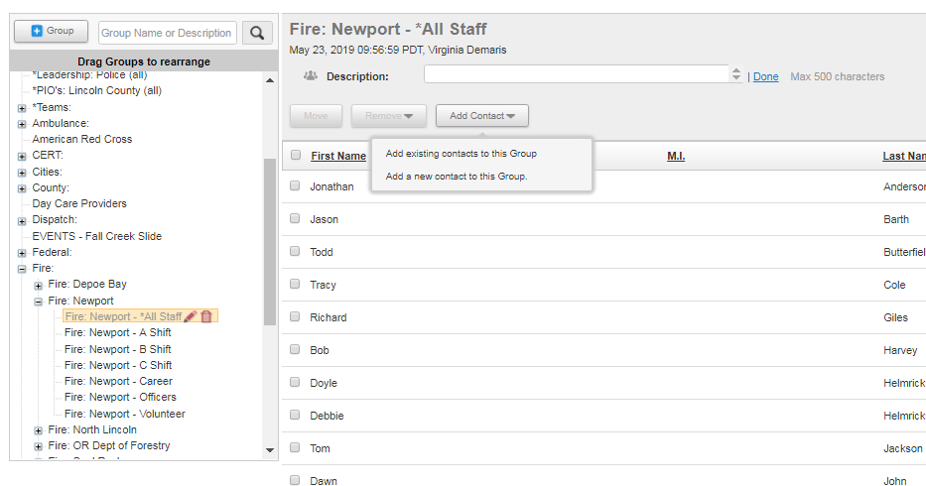
Adding a contact to a group
Click on the “Add Contact” button. You will be given the following options:
“Add existing contact to this Group” – Select this if you already created the new contact
“Add a new contact to this Group” – Select this is you need to create the contact

Slide 13
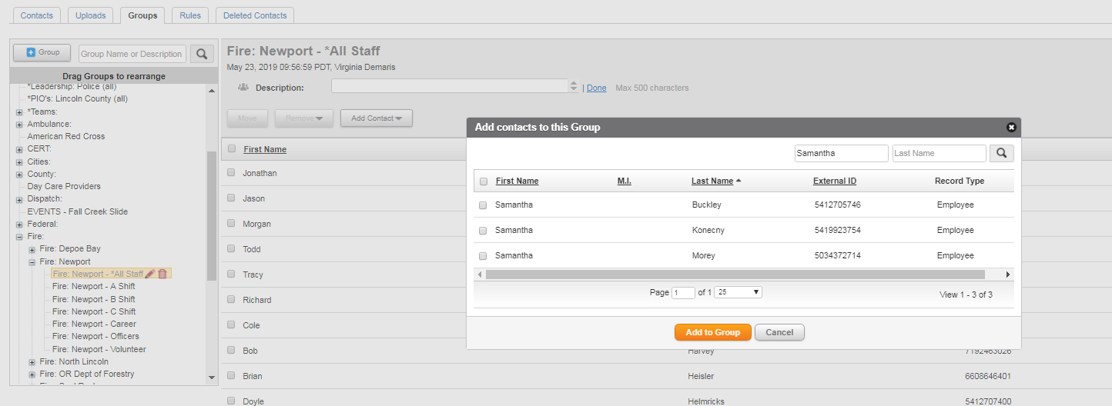
Adding a contact to a group
You have to add the new contact to every subgroup by highlight the subgroup (ex. All Staff, Shift A, etc.) and using the “Add Contact” button.
If you select “Existing Contact”, you will be able to search the contacts that are visible to you.
Use the check box on the left to select which contacts you would like to
add to the highlighted group.

Slide 14
Checking a Group
You can create a new subgroup within your agency by using the “+Group” button.
You can check the contacts in a subgroup, but selecting that list from the menu.
The highlighted subgroup contact list will be visible on the right.

Slide 15
Section c: Sending messages

Slide 16
Sending Messages
To send messages, go to the Notifications Tab. You will be able to see previous messages, scheduled messages, and templates. Select “New Notification”

Slide 17
Sending Messages: Flash player download
When the message opens, you might have to click the puzzle piece to approve the use of Flash Player.
Do not start your message until you are sure Flash Player is loaded.
Once you click the puzzle piece, any information you put in the message box will be reset to blank field.

Slide 18
Sending Messages
Title: Create a title following the format “Agency Abbreviation – Message Title” Example: LCSO – Radio Update
Message: Fill in your message. Try to keep it short - It will be sent via text message
Speech: You can select to do text-to-speech or use a voice recording, if you are activating phone devices
Save as a template: Select this box if you would like to save the message as a template
Attach Files: Click Attach Files to include an attachment with your message – this is only for emails
Click this box to include a separate message, sent only to email. It will open a second text box for the email only messaging.

Slide 19
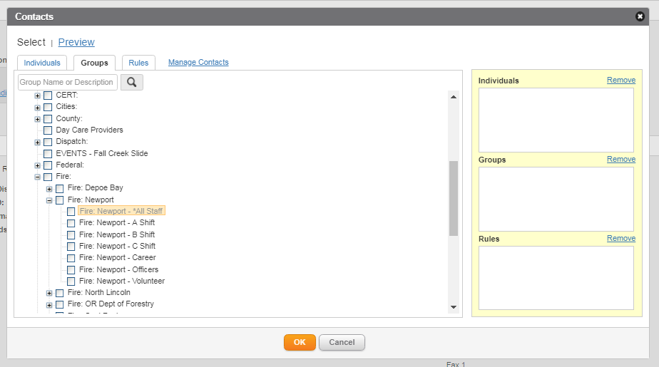
Sending Messages
Publishing Option: We do not use this feature at this time.
Contacts: To select contacts, click on the “groups” link.
This will open a second box with tabs for “Individuals”, “Groups”, or “Rules”. You can select from “Individuals” or “Groups”.
We do not use “Rules” at this time.

Slide 20
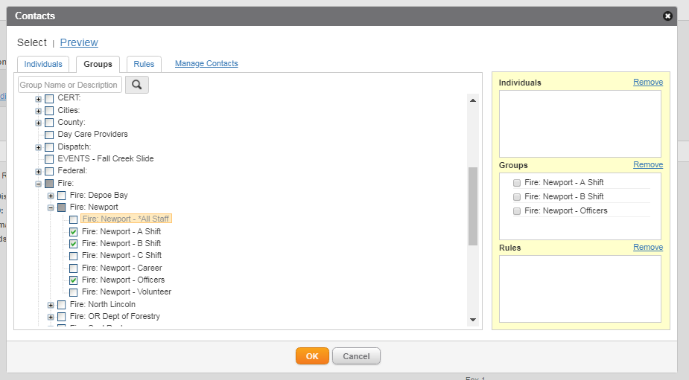
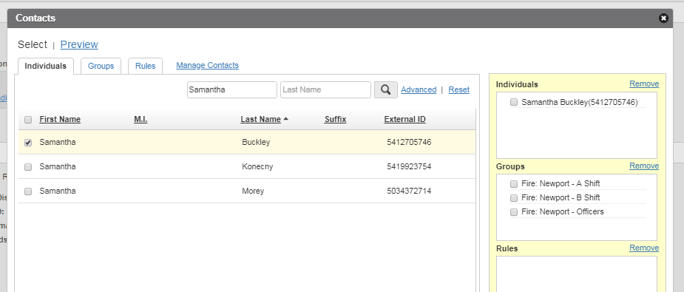
Sending Messages
To Select Groups:
Using the groups tab, check the boxes on the left to select which subgroups you want to receive the message.
To Select Individuals:
Using the Individuals tab, search for people you want to receive the message. Click the box on the left to select someone.
Selected groups and individuals will be visible on the right side of contacts box. You can remove them by checking the box and clicking “remove”.

Slide 21
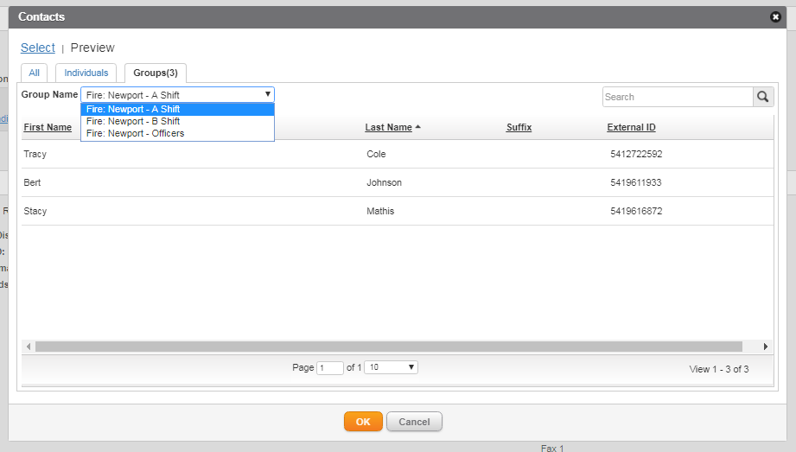
Sending Messages
Check to make sure you have to correct number of groups and individuals selected on the message screen. Click “preview contacts” to make sure you have selected to correct groups/individuals.
The preview contacts gives you the option to view individuals, groups or all contact.

Slide 22
Sending Messages
Message Settings: To change the message settings, click “edit”. This will open the message options.
Sender E-mail Display & Sender caller ID: You can change these to reflect your organization (i.e. Newport Fire).
Request Confirmation: If you request a confirmation, the messages will stop cycling through the delivery methods as soon as the recipient confirms receipt.

Slide 23
Sending Messages
Select which delivery methods you would like to receive the message.
The message will cycle through the delivery methods in the preferred order established in each persons profile.
You can also select from the drop down box in the top right corner.
All – Highlights all delivery methods
All Text – Highlights all options that delivery messages in text (i.e. text message, email, etc.)
All Voice – Highlight all options that deliver voice messages (i.e. phone calls)

Slide 24
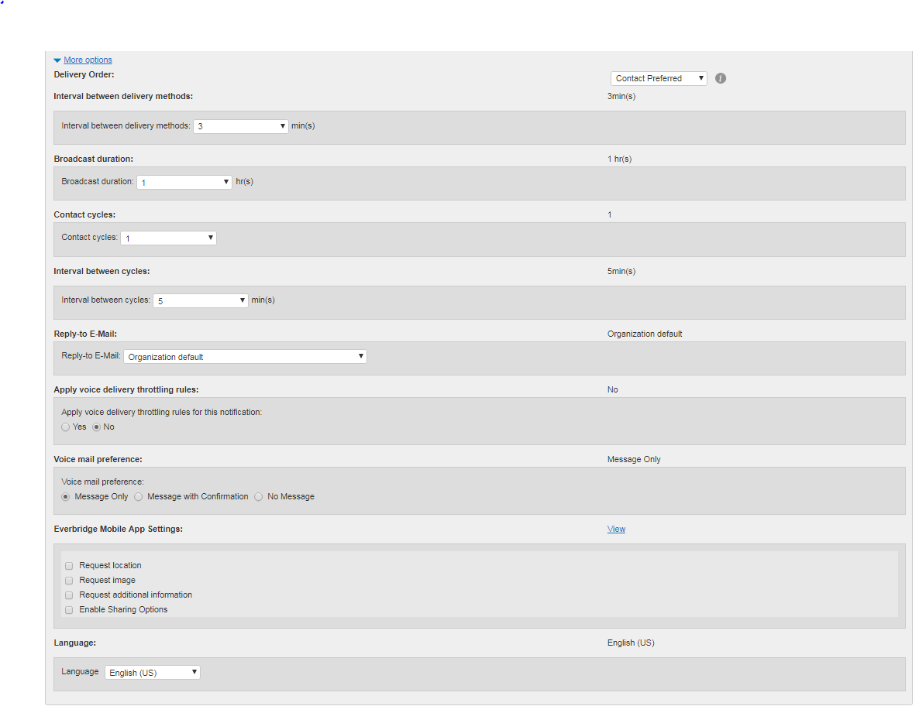
Sending Messages
Select “more options” to change other settings. Emergency Management recommends that you leave most of these settings as they are. Settings you might want to change are:
Voicemail preference: You may opt to not leave a voicemail
Everbridge Mobile App Setting: You may decide to request a location, image, or other information using the Everbridge mobile app. This feature is only available to those who use the Everbridge mobile app.

Slide 25
Sending Messages
Before you send your message, review all the information including :
Content – Is the message clear and concise?
Recipients – Have you selected all the appropriate people to receive the message?
Attachments – Have you attached necessary documents?
Settings – Are the send settings correct (i.e. confirmation request, correct delivery method, etc.)
You can send the message now, or set it to send later. You can also select it to reoccur.
You can “Save” the message as a template.
Once you have reviewed, click the “Send” button.

Slide 26
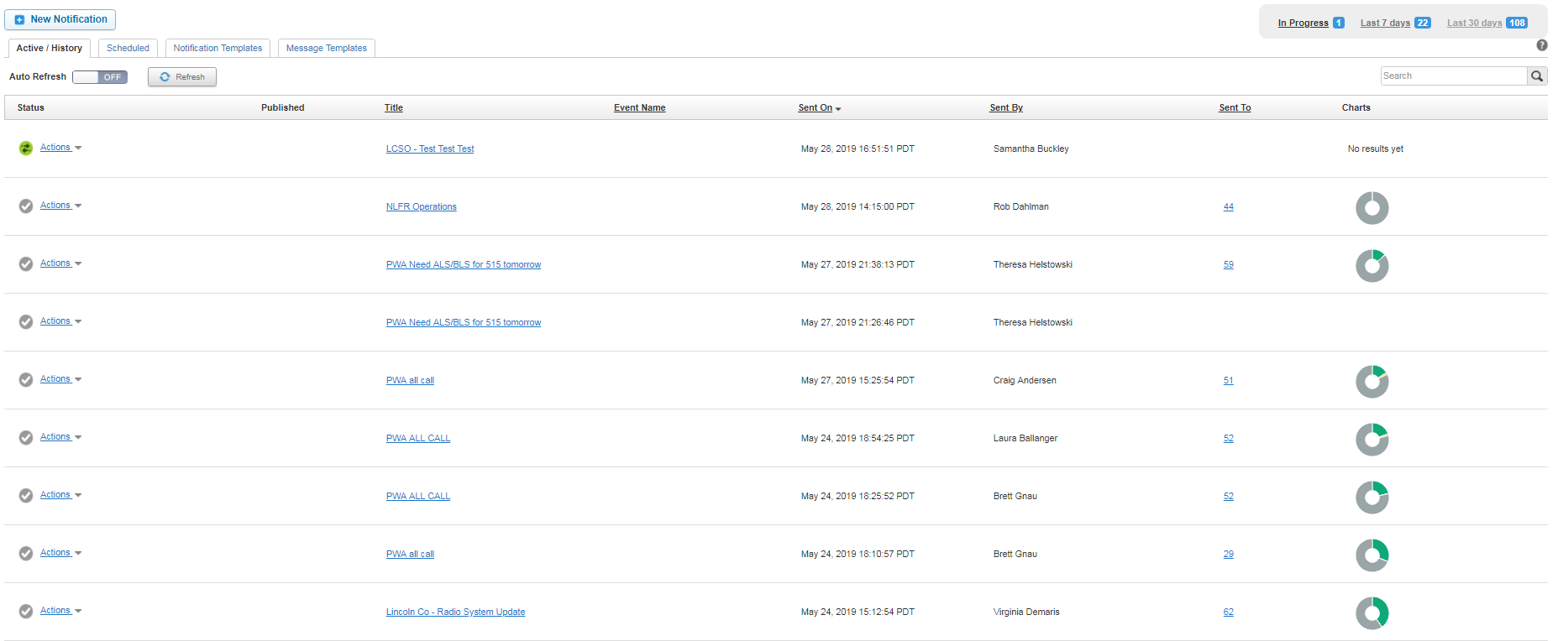
Sending Messages
After sending the message, you will be taken to the notification screen. Your message will be at the top of the notifications. It will show who sent the message, when the message was sent, and how many people confirmed.

Slide 27
Questions or assistance
County Emergency Manager(s)
Tiffany Brown, brown@co.clatsop.or.us
503-338-3774
Laura “Pooka” Morales, lmorales@co.clatsop.or.us
503-325-8645
Dispatch – For urgent message for “team activations” contact your sponsoring Dispatch Center.

